Slide 1
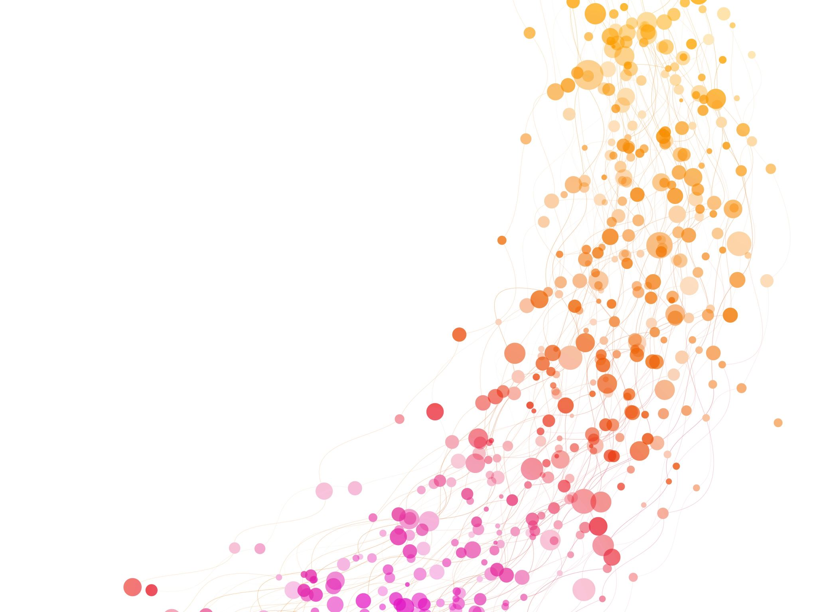
Project 1: Viral Hepatitis in Singapore
Gautam Raman

Slide 2
Agenda
Setting the context
Defining the problem
Analysis
Addressing the problem
Future scope

Slide 3
Viral Hepatitis: What is it?
Hepatitis | Cause | Transmission Route
A | Hepatovirus | Food and water borne
B | Orthohepadnavirus | Blood and body fluids, parenteral, perinatal, sexual
C | Hepacivirus | Blood and body fluids, parenteral, perinatal (uncommon), sexual (not well defined)
D | Deltavirus | Co-infection with HBV or super-infection in a chronic HBV carrier.
E | Hepevirus | Mainly water-borne
Definition: Viral Hepatitis is caused by viruses which specifically target the liver tissue.
There are several different viruses that cause hepatitis, including Hepatitis A, B, C, D, and E.
Source: National Centre for Infectious Diseases Singapore

Slide 4

Viral Hepatitis in Singapore
Some hepatitis strains affect as many as 1 in 25 Singaporeans. Hepatitis is endemic in Singapore (Gan, 2022).
GSK is building a new S$343 million manufacturing facility in Singapore for Hepatitis B vaccines (CNA, 2023).
Sub-optimal understanding of liver diseases, risk factors, and potential complications (Tan et al., 2021).

Slide 5
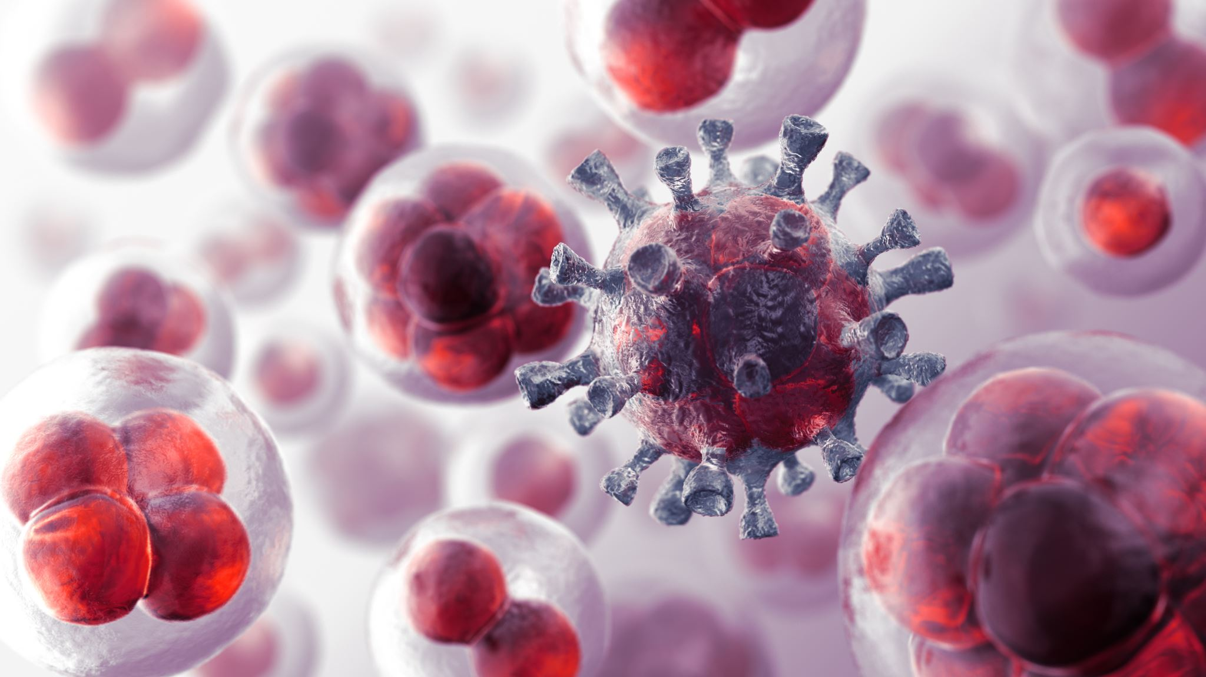
Problem Statement
“Is there a relationship between recorded cases of Viral Hepatitis and any weather indicators in Singapore? How can this be leveraged to create better targeted campaigns?”

Slide 6
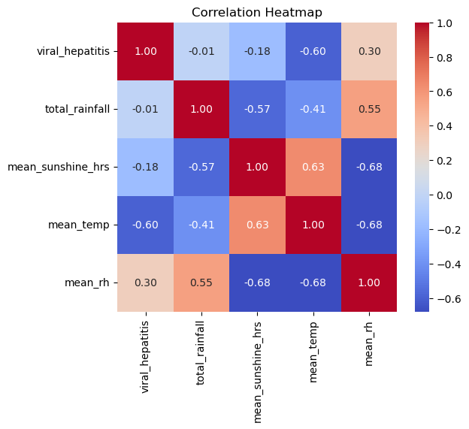
Exploring the relationship of Hepatitis and the Weather
A correlation heatmap was created to determine if there was a relationship between any weather indicators and Viral Hepatitis.
It was found that, from 1982 to 2021, the annual mean surface air temperature and number of Viral Hepatitis cases recorded were moderately (negatively) correlated.

Slide 7
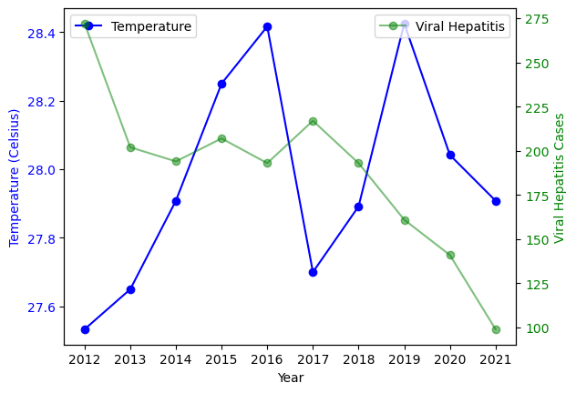


The Relationship Visualised
It is observed that, in the past ten years, generally, as the temperature increases, recorded cases of Viral Hepatitis decrease and vice versa.

Slide 8
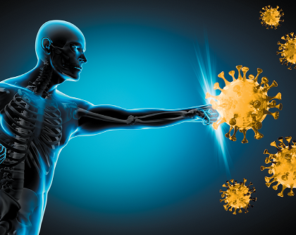
Why, though?
Studies conducted suggest that survivability of hepatitis virus decreases with temperature (Mbithi et al., 1991).
It is also likely that a change in temperature drives hygiene habits in people.
Immune cells are more sluggish colder weather, leaving people more exposed to infection (Thebarge, 2021).

Slide 9
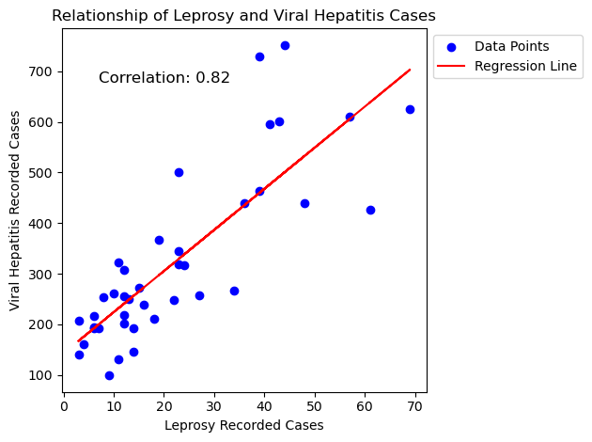
Side Note: Viral Hepatitis and Leprosy
It was found that Leprosy and Viral Hepatitis have a strong positive correlation (0.82)!
Indicative that Leprosy can cause co-infection with Hepatitis (especially Hepatitis B) (Beate et al., 2021).
Key takeaway: Campaigns targeted at Leprosy should also spread awareness about Hepatitis.

Slide 10

Addressing the Problem (1/2)
Q: Is there a relationship between recorded cases of Viral Hepatitis and weather indicators?
A:
Viral Hepatitis and air temperature are modestly negatively correlated.
There are several direct or indirect ways that temperature can affect Viral Hepatitis.
Recommendation: Create campaigns to inform the public about the relation of weather with Hepatitis.

Slide 11
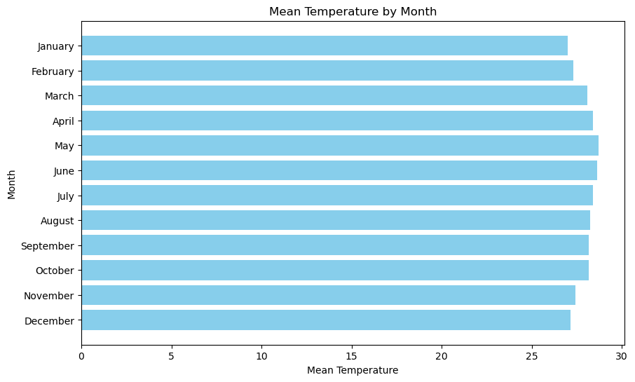
Addressing the Problem (2/2)
Q: How can this be leveraged to create better targeted campaigns?
A:
January, February, November, and December are the colder months in Singapore since 2012.
Recommendation: Create two buckets to separate various campaigns; Year-Round and Targeted.
Year-Round Campaigns: Can be run throughout the year. Examples include vaccination drives, sex education in schools, needle exchange programs, and blood screening.
Targeted Campaigns: These should be pushed specifically during colder months to help mitigate Hepatitis infections. Examples include promoting good hygiene, advocating safe sex between adults and other awareness campaigns.
Moreover, Hepatitis could be integrated into campaigns about other diseases (like Leprosy).

Slide 12
Future Scope
The data could be further analysed by Hepatitis type, giving a more detailed look of the relation of each type to the weather.
Instead of looking at yearly data, an analysis on the monthly level could be done to give an in-depth look at infection trends.
The relation of hygiene behaviours with the weather could be studied further to give insight into what behaviours are triggered in different conditions.

Slide 13


Slide 14

Q&A

Slide 15

References
https://www.ncbi.nlm.nih.gov/pmc/articles/PMC7904891/
https://journals.asm.org/doi/abs/10.1128/aem.57.5.1394-1399.1991
https://www.channelnewsasia.com/watch/pharma-giant-gsk-build-singapore-facility-making-hepatitis-b-vaccine-video-3627206
https://onlinelibrary.wiley.com/doi/full/10.1111/jgh.15496
https://www.ncid.sg/Health-Professionals/Diseases-and-Conditions/Pages/Hepatitis.aspx
https://www.todayonline.com/singapore/how-much-do-you-know-about-hepatitis-b-and-what-if-youre-silent-carrier-virus-1951356
https://www.gohealthuc.com/library/surprising-things-do-and-dont-affect-your-immune-system

